Slide 1
Safety of Formula 1, looking at the first straight and turn
Kevin Wilbrink (6310621) and Jordi Wippert (6303013)
Notes:
Kevin

Slide 2
Content
Problem introduction
Nagel-Schreckenberg traffic model
Adjusted model
Simulation
Results and conclusion
Discussion
Notes:
Kevin

Slide 3
Problem introduction
Formula 1
20 cars driving each circuit, 20 per season varying in speeds and layout
Safety
How can we improve the safety of Formula 1 by looking at the first straight and turn of circuits?
Notes:
Jordi

Slide 4
Nagel-Schreckenberg traffic model
Constraints:
Single lane
No crashes
Steps in each update of the simulation:
Acceleration
Slowing down
Randomization
Car motion
Notes:
Kevin

Slide 5
Adjusted model
Constraints:
Circuits
Startgrid
Multi-lane
Turn
Notes:
Kevin

Slide 6
Adjusted model (2)
Steps in each update of the simulation:
Accelerating/ braking
Overtaking
Defending
Optimal line
Notes:
Jordi

Slide 7
Adjusted model (3)
Additional behaviour:
Last moment switch
Crash/brake based on random number
Notes:
Jordi

Slide 8
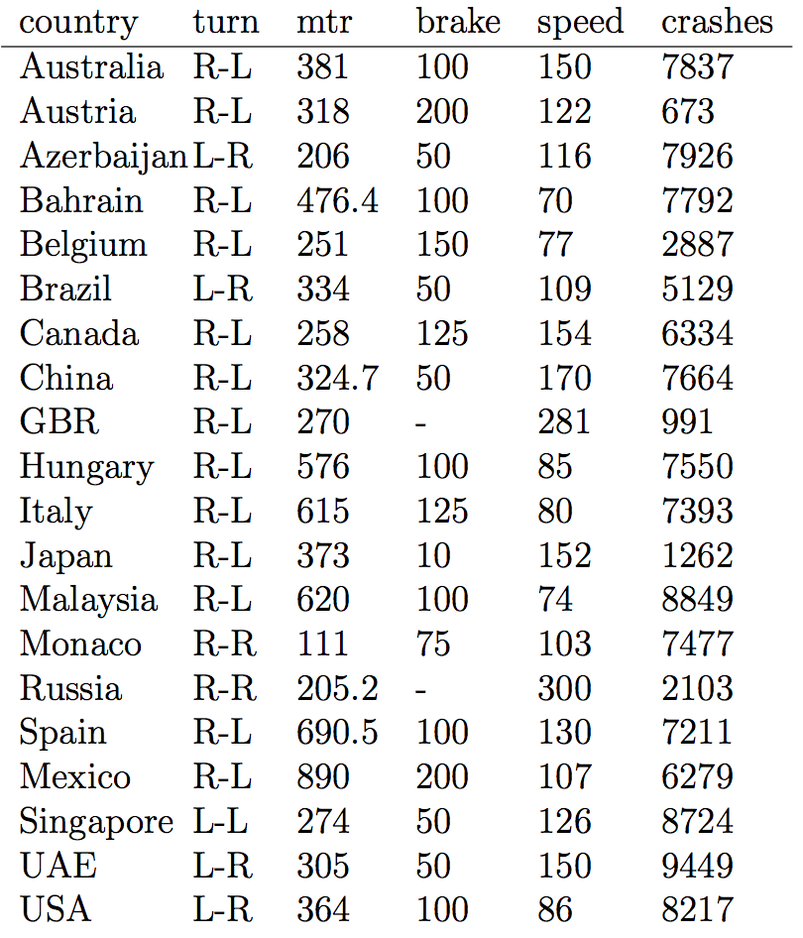
Simulation
10,000 runs for each circuit
121,747 crashes
Notes:
Kevin

Slide 9
Results
Real-world
Notes:
Kevin

Slide 10
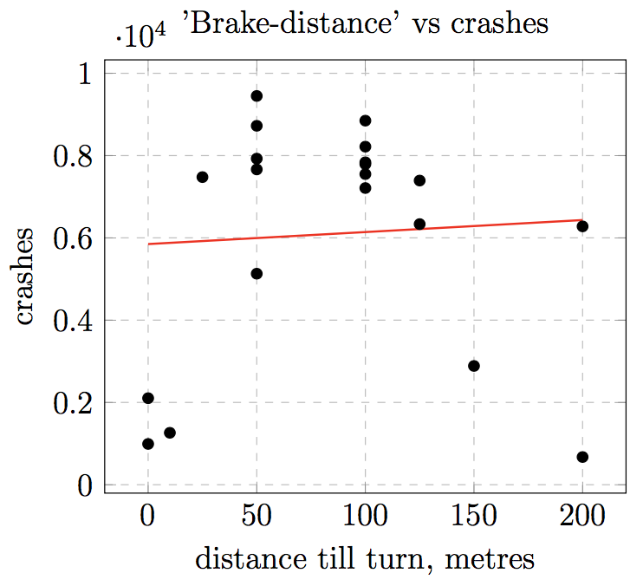
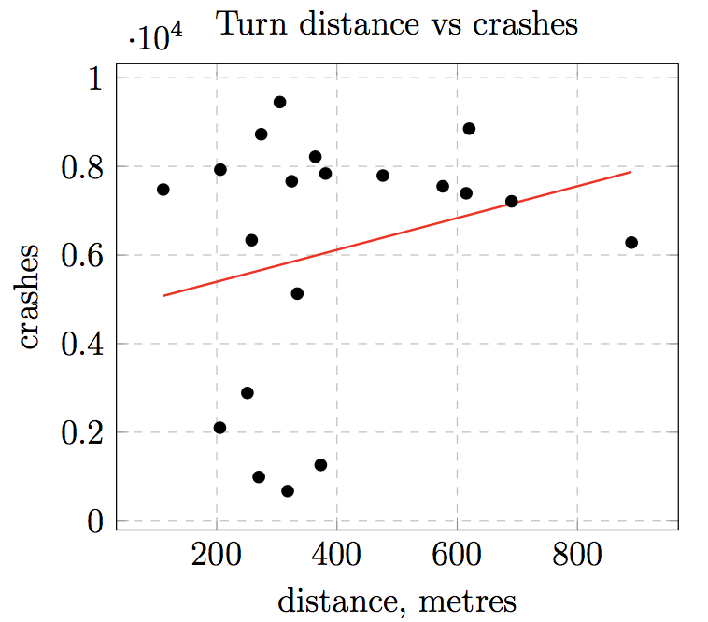
Results (2)
Notes:
Jordi

Slide 11
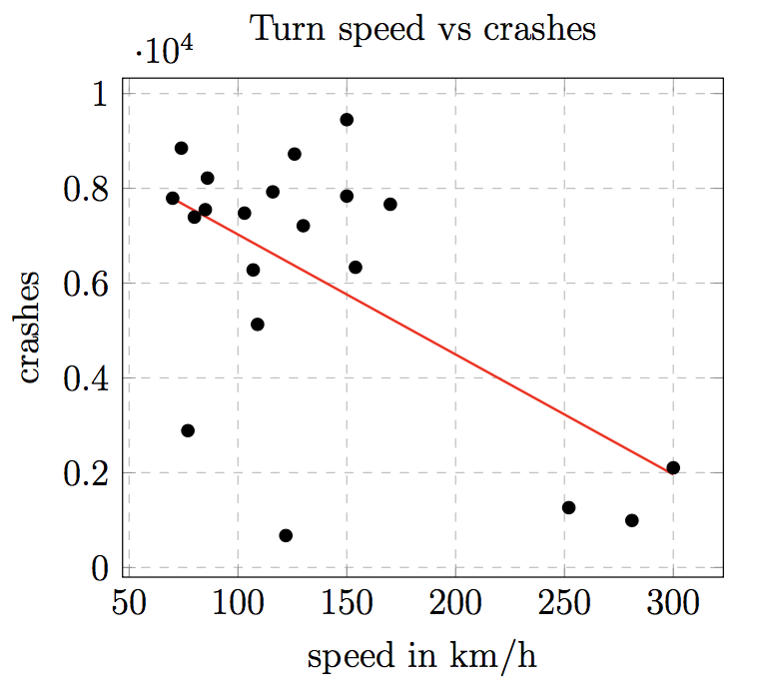
Results (3)
Brake distance
Proportional amount of crashes
Turn distance
Small increasement of the amount of
crashes as the distance gets longer
Turn speed
As the speed goes up, the amount of
crashes descreases
Notes:
Kevin

Slide 12
Discussion
Future model improvements
Acceleration
Rows
Crashes
Notes:
Jordi

Slide 13
Our research shows that there’s no significant indication to change (brake) distances, while safety seems to be improved by driving at higher speeds in turn one.
Notes:
Kevin

